Slide 1
CS 419: Production Rendering Specular Reflection
Eric Shaffer

Slide 2

Objectives
Understand one way of modeling glossy specular
Know how specular reflection can be implemented
Seen how how a lighting model can be view-dependent

Slide 3
Modeling Specular Reflections
Glossy specular refection clusters reflection directions around the mirror reflection direction
Call this direction r…we must derive an expression for it…

Slide 4
Modeling Specular Reflections

Slide 5
Modeling Specular Reflection
How do we model clustering of radiance around r?
Decrease radiance as angle between r and ω_{o} increases

Slide 6
Modeling Specular Reflection
How do we model clustering of radiance around r?
Decrease radiance as angle between r and ω_{o} increases
Phong Specular Model

Slide 7
The Phong Model is Non-Physical
Lacks reciprocity and does not conserve energy…among other things
Can modify reflected specular radiance to be:
Conserves energy if k_{d}+k_{s} <1.0

Slide 8
A Full Phong-style Reflection Model
For n point and directional lights
j is index for each light

Slide 9
Problems with Indirect Lighting
Using this Phong-stye BRDF would be problematic for inter-reflections

Slide 10

Example of Increasing e

Slide 11
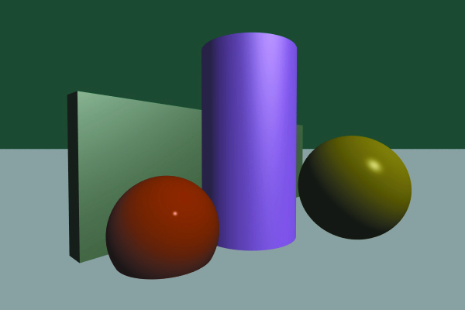
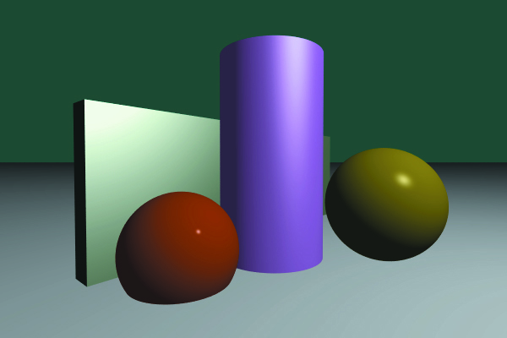
Example: Directional and Point Light

Slide 12
Viewer Dependence
Note that specular highlights depend on position of the eyepoint
Fix the position of the surface and light
The apparent position of the highlight is different for positions a and b

Slide 13
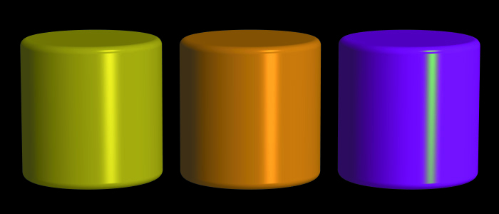
Colored Highlights
Suppose you want non-white highlights even when the light is white….
Introduce a specular color c_{s}

Slide 14
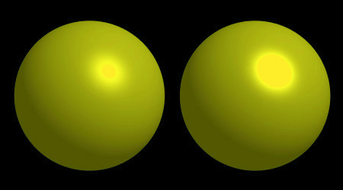
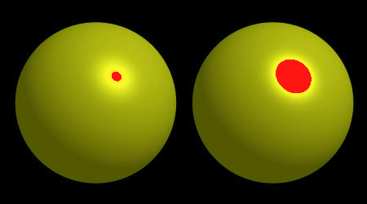
Overflow

Slide 15
Blinn Modification
Jim Blinn suggested using the halfway vector h instead of r
When would this be beneficial?

